Slide 1

The Ethics and Economics of Environmental Protection
4. Consequentialism

Slide 2
1. The module so far
 | Topic | Problem | Debate
1 | The “limits to growth” debate | The effects of human expansion on resource availability | Malthusians vs. Prometheans
2 | Risk, sustainability, and ethics | Our ignorance of the future | Strong vs. weak precautionaries
3 | Deontology | The ambiguity of reason | Narrow vs. broad church rights
4 | Utilitarianism | The ambiguity of consequences | Narrow vs. broad church preferences

Slide 3
Ethics, principles, and the question of authority
Ideal-regarding principles
Want-regarding principles
The ethical continuum in the limits debate
Uncoordinated Δ is generally bad
Uncoordinated Δ is generally good
Reason
Preferences
Kantian autonomy
Schmidtzian judgement
Rule utilitarianism
Act utilitarianism
Note these two positions tend towards one another

Slide 4
Consequences and market rationalism
(or, whether economic analysis (“EA”) is appropriate for ethical problems)
 | Ideals | Wants
1. | EA entails commodification | EA entails only that individuals make separate value judgements
2. | EA requires discrete, easily demarcated objects | EA requires that welfare gains be discrete, but the goods that provide them may take any form
3. | Economic approaches presume a pre-existing distribution of abilities and resources | EA does take our existing positions as its starting point, but its aim is to change this
4. | Economics is blind to the quality of reasons | Economics allows for the use of reasons, but these must be subject to practical comparison
5. | The economic test for welfare gains (the “compensation test”) has no connection to well-being | The economic test clarifies our trade-offs; how we respond to them cannot be answered by economic argument

Slide 5

2. Utilitarianism
Utilitarianism’s appeal is that it is an impartial, consequentialist principle
  Suppose you could be any of the n members of a society
  Expected well-being = (1/n)U₁ + (1/n)U₂ … + (1/n)U_{n}
  This is equivalent to the average welfare in society
Why care about welfare?
  It is a “primitive” (what else can we plausibly care about?)
  It is the only way of evaluating conflicting and incomplete virtues
What are the big objections?
  People may have objectionable preferences
  It is easy to imagine a situation where even understandable preferences require us to do objectionable things (so-called “Trolley problems”)

Slide 6
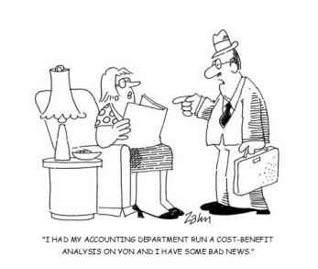
Utilitarianism and economic analysis
The ideal market yields “Pareto optimal” outcomes
  A distribution (say, D₁) is Pareto optimal if there is no other distribution (D₂) that is preferred by one or more persons and all other persons are indifferent
  In other words, Pareto optimality obtains when we cannot make anyone better off without making someone else worse off
An ideal market is the best way of identifying which Pareto optimal outcome is socially preferable
  Ideal markets exhaust all potential Pareto-efficient exchanges
  At equilibrium, exchange is possible only if sellers receive lower prices than costs, or buyers offer higher prices than benefits
  Centralised cost-benefit analysis (CBA) is a rational substitute for real-world markets containing externalities and public goods
CBA therefore appears to be particularly useful in the environmental sphere

Slide 7
Cost-benefit analysis and welfare
CBA proceed by aggregating preferences, on the assumption that the satisfaction of preferences enhances well-being
  To satisfy preferences is to increase an individual’s well-being; the stronger the preference, the greater the benefit to well-being
  Preference aggregation rationally (i.e., impartially) trades costs (preferences against) against benefits (preferences for)
  E.g., consider the siting of a new housing development: is the cost (the loss of green belt, etc.) outweighed by the benefit (the provision of new homes)?
 | I. Preferences = well-being | II. Preferences indicate well-being
Logic | To satisfy a preference is to directly improve well-being | Preferences suggest which objects generate desirable subjective states
Reasons for | Well-being simply is subjective preference satisfaction | Only informed preferences reliably generate utility
Reasons against | Some preferences are deluded or mistaken | Quickly devolves into an argument about the qualities of objects, not subjects

Slide 8
Varieties of utilitarianism
 | I. Bentham | II. Mill
Crown principle | HEDONISM: “Nature has placed man under the governance of two sovereign masters, pain and pleasure.” | WELFARISM: “To suppose that life has no higher end than pleasure… is a doctrine worthy [only] of a swine.”
Application | External: Utilitarian calculations depend upon agents’ revealed preferences | Internal: Utilitarian calculations depend on agents’ moral perfection
Obstacle | How can policy-makers we compare different agents’ utilities? | How can policy-makers cultivate an enlightened public?
Political implications | Focus on avoiding pain rather than cultivating pleasure | Focus on developing agents’ autonomy rather than satisfying immediate preferences
Summary claims | There are no simply good policies; instead, we ought to choose pragmatic acts | There are no eternal solutions to our conflicting preferences; instead, we ought to deliberate appropriate rules and preferences

Slide 9
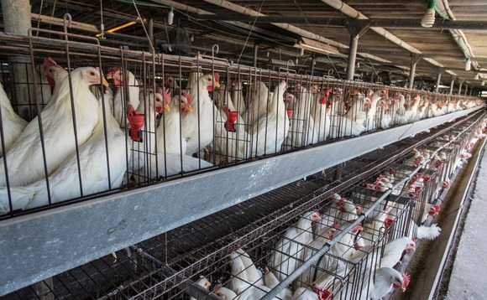
3. Utilitarianism and the environment
Peter Singer adopts a form of act utilitarianism known as “preference utilitarianism”: the maximisation of interests, rather than pleasure as such
Singer avoids the problem of how to know animal interests by focusing, like Bentham, on problems: all sentient creatures can suffer, and we are obliged to avoid this
Singer assiduously charts the harms of animal testing, animal farming, & trophy-hunting; we would not visit these harms on the disabled or those with learning difficulties, so we shouldn’t visit them on animals
Singer’s argument has two further strengths:
  The ambiguity between Benthamite and Millian utilitarianism disappears; animals cannot achieve moral excellence
  Biocentric utilitarianism resolves the problem over who has standing: non-sentient animals and plants do not count in preference utilitarian calculus because they do not have interests

Slide 10
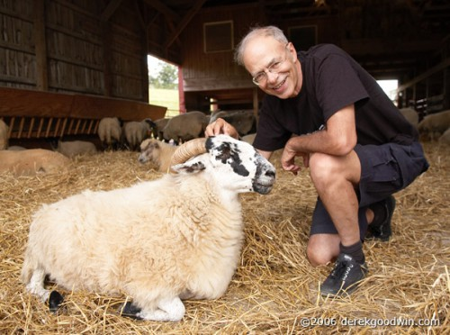
Is utilitarianism for animals coherent?
Intrinsic problems
  How can we judge “sentience”?
  Is suffering the only problem? If we could breed painless and fearless pigs, would it be OK to kill them for pleasure?
  Do animals pose the “identity problem” in the same way that humans do?
Extrinsic problems
  Should we intervene in the natural world to reduce pain? What would count as a reasonable cost of reducing pain?
  Must we domesticate animals so we can control their welfare?
  How do we trade-off human pleasures (and the costs of forbearance) against animal suffering? (Is free range meat more acceptable than battery farmed meat?)

Slide 11
So… can want-regarding principles be defended?
Commodification, or cold-heartedness
  Markets confuse environmental objects with their effects: utilitarian economists care only about the latter, and assume that objects should be manipulated to realise the effects we want, not that are intrinsic to the object
Intrinsic, indefeasible value
  Economic calculus require that goods, and their values, can be demarcated and bargained up or down; this is not only in many cases impossible; but the act of demarcation destroys the values in question (e.g., taking animals out of their wild habitats)
Distribution and discrimination
  If “wants” are elided with “ability to pay”, then economic calculus necessarily discriminates against the poor—and, with them, much of nature, which is rarely able to “pay its way”
The “Oscar Wilde” problem
  Does the utilitarian-economist know the price of everything, but the value of nothing?
The focus on “compensation variation”, rather than actual well-being
  The utilitarian calculus compares social benefits and costs despite the distributional effects they have; if cutting down a forest beings business (say) £100 extra, but the community is £95 poorer, then the utilitarian says: bingo!, despite the fact that the community is not (and probably cannot be) directly compensated

Slide 12

4. Summary
Our choice of ethics can be summarised, or simplified, as choice between the authority of ideals, and the authority of wants
The world, of course, has made its choice: it is ruled by wants (utility), with a few ideals around the edges (e.g., human rights—for what they’re worth)
But we can, immediately, find lots of problems with this: do these cause a prima facie problem for economic analysis? And what about less anthropocentric (i.e., human-centric) applications of utilitarianism?
We investigate the latter question by first considering utilitarianism as a principle, and then its application to nature
Utilitarianism is notionally impartial between different wants, and their holders; its standard is that social outcome that improves the position of the average individual (which loosely entails “the greatest benefits” for all)
Utilitarianism emphasises well-being as the one universal good; but it is ambiguous about what counts towards well-being: should we be shocked out of our base preferences, and encouraged to hold morally and culturally excellent ones?
Applied to nature, utilitarianism solves several of these problems, and also seems to maximise the value of the principle’s impartiality
We cannot deny animal suffering… but can we find a non-arbitrary solution to that suffering?

